Slide 1
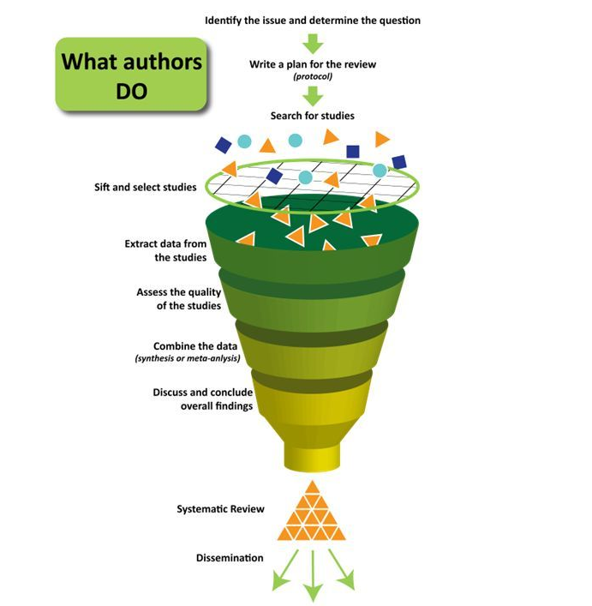
Exploring the impact of student affairs on student learning or student achievement throughout empirical studies: A systematic analysis of literature
Huzeyfe Cakmakci & Qichen (Ellu) Li
University of Florida, Student Affairs, Office of Assessment and Research
Introduction
Procedures
Results
Conclusion
Student affairs provides various out-of-the classroom learning venues that support the learning and education of the “whole student” (Sandeen, 2004). The importance of the student affairs is well established. The function of student affairs is becoming more complex due to diverse age, academic, social or financial background of students (Sandeen, 2004). This study consists of the systematic review of the published articles regarding the impact of student affairs on learning or achievement.
Inclusion Criteria
The purpose of this study is to review articles that provide exemplar work from student affairs. We want explore empirical findings that include an association between student affairs and student learning. Therefore, we created the following inclusion criteria for this poster study:
1- The articles need to have a discussion or a comprehensive recommendation for student affairs professionals, or test the effectiveness of a program within student affairs.
2- Only research or empirical studies where researchers used quantitative, qualitative or mixed methods will be included to the review.
3- The articles need to provide evidence for the student learning, achievements or other positive outcomes.
4- Only studies conducted in the US will be included in the review.
5- Only peer reviewed articles will be included in the review.
Article selection steps
On August 22, 2018, a search was conducted on a publication database PsycInfo by using the EBSCOhost. The search terms included "Student affairs" AND "Assessment" OR “Evaluation" OR “Data" OR “Empirical studies" OR "Qualitative" OR “Quantitative" AND "Learning" OR “Outcomes" OR “Achievement". The result of the search provided 222 articles. When we added peer reviewed articles only the number decreased to 89 articles. After reading all the abstracts of the articles we ascertained that 28 articles met the inclusion criteria and provided empirical results for student affairs professionals. After reading all of those articles we found that 9 articles were out of scope or included issues that did not pertain to our study. The final sample included 19 articles detailed in the following section.
Study | Area | N | Methods | Main findings
Ott, Haertlein and Craig (2003) | Health Center | 1300 |  | Authors emphasized the importance of the collaboration between faculty and student affairs professionals.
Pitcher,Camacho, Renn and Woodford (2016) | LGBTQ+ resource centers, student organizations | 60 | Mixed methods | In order to help LGBTQ+ student pursue college success, the campus should create a supportive environment. Higher education institutes should make improvements on policies, programs, and services to lead to higher LGBTQ+ student outcome.
Schwitzer and Metzinger (2008) | Counseling center | 115 | Mixed methods | Researchers state a clear relationship between the institute’s student learning points and the institute’s outcomes. Additionally, researchers suggested a method which uses Student Learning Imperative to evaluate the Counseling Center’s outcomes.
Baker and Boland (2011) | Campus safety | 600 | Quantitative | The campus should increase safety features (e.g. security camera) and disseminate educational materials focused on safety precautions. The campus communities need to encourage their members to speak up and report an incident.
LePeau (2018) | Diversity and inclusion | 18 | Grounded theory | The campus educators known as “social gadflies” should know by researcher, practitioners, and policymakers because they have made durable influences in campus environment through AA and SA corporation.
Reynold and Chris (2008) | Counseling centers | 94 | Qualitative case study | Researcher indicates that students need more assistance and encouragement from counseling center staff to develop skills to manage the emotional regulation.
Michael and Patricia (2002) | Student development and advising center | 608 4703 | Mixed methods | Students on academic probation at the first end of the semester are significantly less likely to enroll in the next semester. Students’ learning strategies have high impacts on their academy performance and retention rate.
Shivpuri et al. (2006) | College admissions | 644 | Quantitative | A student who had higher SAT/ACT would be more successful in academic performance than those who had lower scores.
Rhoads (1995) | LGBT+ Diversity | 40 | Qualitative ethnographic study | Student Affair staffs should develop strategies to prevent LGBTQ+ students experience harassment and discrimination.
Gulley (2018) | Student affairs and academic affairs | 17 | Qualitative | The collaboration of AA and AS is motivated by student success. For better collaborative practice, all stakeholder should understand how their function aligned with the mission of their division and institution.
Nesheim et al. (2007) | Student affairs and academic affairs | 18 institutions | Qualitative case study | Student affairs and academic affairs partnership program can provide desired outcomes. Asking students what they are learning and how they are learning can provide valuable information.
Ting (2000) | Student affairs | 96 | Quantitative | The researcher found that sat scores and selected noncognitive variables can provide information to predict academic performance among Asian American students.
Brandenberger and Bowman (2015) | Higher education | 1400 | Quantitative Hierarchical linear modeling | Students college experience predicted on prosocial outcomes. Active forms of learning and engagement with diversity were suggested to improve prosocial outcomes.
Miles (2011) | Student governments | 13 | Qualitative | Students who participated in the interviews indicated that they wanted to work closely with administrators to improve their campuses. They desire to understand the procedure but wanted to have the freedom to challenge the tradition.
Murray et al. (2004) | Student affairs | 49 | Quantitative Experimental and control groups | Authors suggested that student affairs professionals should be familiar with faculty research related with the student affairs to establish collaboration. Research assistants who are trusted and well respected both from student affairs and faculty play a critical role in this collaboration.
Carpenter and Peña (2016) | Higher education | 14 | Qualitative | First generation students have the ability to achieve self-authorship in the earlier stage of life.
Kochenour et al. (1997) | Student affairs | 11000 | Quantitative ANCOVA | Supplemental instruction program is an effective program. Researchers suggested that student affairs professionals can use it to improve student development.
Edwards and McKelfresh (2002) | Living learning center | 81 | Quantitative | The result of the study revealed that living Ingersoll residential college had a positive impact on academic success.
Scofield et al. (2017) | Counseling center | 6473 7162 | Quantitative ANOVA | Counseling center clinicians should monitor the length of the student's treatment. Students who struggle the academically tend to use services more than average students. The length of treatment played an important role in the academic decision-making process.
  The most consistent finding and suggestion among these 19 articles was the collaboration between student affairs and faculty to improve student learning and development.
  Your text goes here.
Limitations
  Researchers for the current study used only one publication database which would potentially limit the variety of the publications. In order to reach more empirical research articles other publication databases such as Eric, Web of Science, and Academic Search Premier should be used as well.
Methods
The current study was conducted by using the systematic review method. Systematic reviews can be accomplished with a comprehensive plan and search strategies to include all relevant articles to the particular topic. Uman (2011) provides eight stages to a systematic review:
1 Formulate the review question
2 Define inclusion and exclusion criteria
3 Develop search strategies and locate studies
4 Select studies
5 Extract data
6 Assess study quality
7 Analyze and interpret results
8 Disseminate findings
Selected References
  Brandenberger, J. W., & Bowman, N. A. (2015). Prosocial growth during college: Results of a national study. Journal of Moral Education, 44(3), 328-345.
  Murray, J. L., Naimoli, P. H., Kagan, R. S., Kirnan, S. M., & Snider, B. R. (2004). Reflections on the Use of Undergraduate Research to Support Student Affairs Assessment. Journal of College Student Development, 45(2), 243-252.
  Pitcher, E. N., Camacho, T. P., Renn, K. A., & Woodford, M. R. (2018). Affirming policies, programs, and supportive services: Using an organizational perspective to understand LGBTQ+ college student success. Journal of Diversity In Higher Education, 11(2), 117-132.
  Sandeen, A. (2004). Educating the whole student: The growing academic importance of student affairs. Change: The Magazine of Higher Learning, 36(3), 28-33.
Contact information
  Huzeyfe Cakmakci
  Huzeyfe@ufl.edu
  Office of Assessment and Research,
  Student Affairs,
  University of Florida
  The diagram was retrieved from the Centre for Health and Communication and Participation.
  Researchers would like to thank Jerri Berri, Martha Massie, Shaun Boren, and Sam Kennedy for their support, feedback and contributions to the poster.

